Slide 1




All World Muslim Educational
Conference (AWMEC)
Presentation Topic
xxxxxxxxxxxxxxx
Date：2025.05.12
gc-university.png
GOVERNMENT COLLEGE UNIVERSITY FAISALABAD

Slide 2

1. Introduction
Soil contamination by heavy metals poses a significant threat to agricultural productivity, food security, and human health, particularly in regions with intensive farming and industrial activity.
In Changshu, China, thousands of acres of farmland have been contaminated by toxic heavy metals, including cadmium (Cd), mercury (Hg), and arsenic (As), primarily due to industrial discharge, improper waste disposal, and excessive use of chemical fertilizers.
Among these pollutants, cadmium (Cd) stands out as a critical concern due to its high mobility in soil, ease of uptake by crops, and severe health risks—including kidney damage, bone degeneration, and cancer—when ingested through contaminated food.

Slide 3
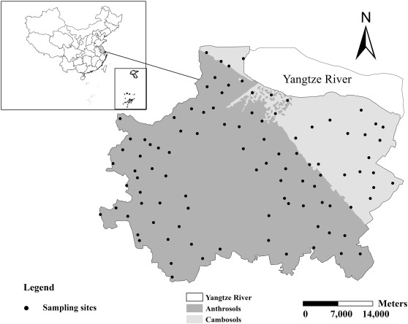
2. Methodology
A comprehensive study by Ran et al., (2014) examined this issue through systematic sampling of 99 paired soil-wheat systems across Changshu (Fig. 1), revealing critical insights about cadmium (Cd) contamination:

Slide 4
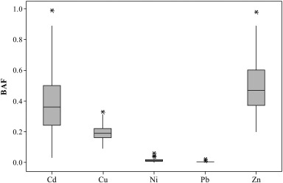
3. Results
Bioaccumulation factor (BAF) of heavy metal concentration between soils and wheat grains.
  Mean total Cd concentration: 0.174 mg/kg (38% above Jiangsu background levels of 0.126 mg/kg)
  DTPA-extractable (bioavailable) Cd: 0.078 mg/kg, indicating significant plant-uptake potential
  Maximum recorded values reached 1.98 mg/kg total Cd - nearly 4× China's maximum allowable concentration (0.5 mg/kg)

Slide 5
4. Discussion
Elevated Wheat Cd Levels
Explanatory variables | Regression equations | P | R2adj | SEE
Soil DTPA-Cd | log Cd wheat = − 0.128 ns + 0.977 log CdDTPA⁎⁎⁎ | 0.000 | 0.542 | 0.243
Soil total Cd, pH | log Cd wheat = 0.703⁎⁎⁎ + 1.04 log Cdtotal⁎⁎⁎ − 0.175pH⁎⁎⁎ | 0.000 | 0.613 | 0.223
Principal component scores of soil Cd, DTPA-Cd and soil major properties | log Cd wheat = − 1.33⁎⁎⁎ + 0.225PCS3⁎⁎⁎ − 0.142PCS1⁎⁎⁎ + 0.076 PCS2⁎⁎ − 0.067PCS11⁎⁎ − 0.057PCS10⁎⁎ + 0.043PCS7⁎ | 0.000 | 0.65 | 0.212
These findings underscore an urgent need for remediation strategies that:
Target bioavailable Cd fractions (DTPA-extractable)
Address local soil conditions (pH, organic matter)
Prevent transfer to staple crops (wheat and rice)
  Strong correlation between soil DTPA-Cd and wheat grain Cd (R²=0.542, p<0.001)
  Bioaccumulation factors (Fig. 2) demonstrate efficient Cd transfer from soil to edible grains
  Multivariate regression models (R²adj=0.65) confirm pH and soil properties critically influence Cd uptake

Slide 6
6. References
Rice and wheat, the staple crops grown in Changshu, are particularly vulnerable to Cd accumulation, leading to potential exposure for millions of consumers.
Given the urgency of ensuring food safety and restoring agricultural land, this study focuses on cadmium (Cd) contamination and explores a feasible remediation strategy to reduce its bioavailability in soil while enabling safe crop production.
By evaluating methods such as chemical stabilization (e.g., biochar amendment), this analysis aims to provide a cost-effective and sustainable solution for rehabilitating contaminated farmland and safeguarding food security in the region.

